Slide 1

Project Title:Predictive Analysis for accident prevention and response
Name: Nyayam Thanuja
Anumandla Neshitha

Slide 2
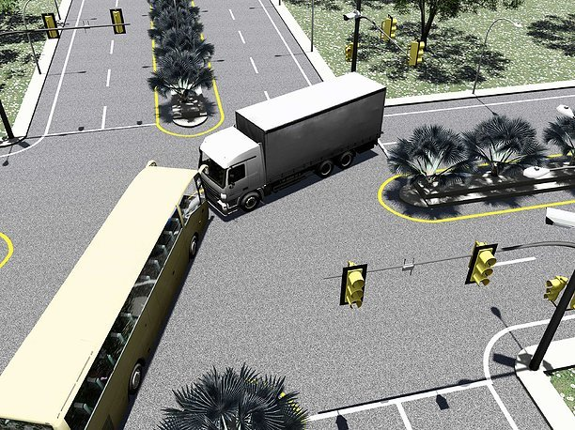
Abstract:
Road accidents are a big problem worldwide,
causing injuries, deaths
costing a lot of money.
Traditional ways of preventing accidents
aren't always very good at stopping new risks.
But now, we have something called
predictive analysis, which helps us predict and prevent accidents better.

Slide 3
Introduction:
Road accidents in India are a significant cause of reduced life expectancy.
They happen due to traffic rule violations, reckless driving, and poor road conditions, especially on highways and hilly areas.
These accidents often occur due to natural factors like fog, leading to poor visibility and consecutive collisions.
Current solutions rely heavily on costly sensor networks.
Using computer vision and low-cost sensors can improve accident classification and target deployment in accident-prone areas more effectively.

Slide 4
Objective:
In this project, our main goal is to use fancy math and computer techniques to predict how bad accidents might be.
We'll look at things like weather, road types, and vehicle details to see what makes accidents worse.
We'll also use maps to find places where accidents happen a lot.

Slide 5
Literature survey:
Nicky Kuttukkaran et al.: Proposed using heartbeat to detect accidents, but Bluetooth range limitations and subjective interpretation of heartbeat make it less reliable.
2.Sanjay Kumar Singh: Found that 50% of Indian cities are prone to road accidents, estimating 250,000 accidents by 2025.
3.Chaitali Khandbahale et al.: Used embedded detection for accident prevention, but high economic cost and sensor malfunction in rainy weather are limitations.
4.Nedjet Dogru et al.: Used clustering algorithm for grouping vehicles based on speed and location, but accuracy during deployment was not optimal.
5.Raad Ahmed Hadi: Studied vehicle detection using background subtraction and feature-based tracking.

Slide 6
Existing system:
Existing systems for predictive analysis for accident prevention and response vary depending on the context and the specific needs of the stakeholders involved.
1.Traffic Management Systems
2.Connected Vehicle Systems
3.Public Safety and Emergency Response Systems
4.Weather and Environmental Monitoring Systems
5.Machine Learning and AI-Based Solutions
These systems play a crucial role in improving road safety, reducing accident rates, and
minimizing the impact of accidents on public health and safety.

Slide 7
Proposed System:
A proposed system for leveraging connected vehicle technology and predictive analytics for accident prevention could include
1.Data Collection
2.Data Transmission
3.Data Processing and Analysis
4.Data Storage and Analysis
The proposed system leverages connected vehicle technology and predictive analytics to proactively identify and prevent accidents, ultimately improving road safety and reducing the number of collisions.

Slide 8
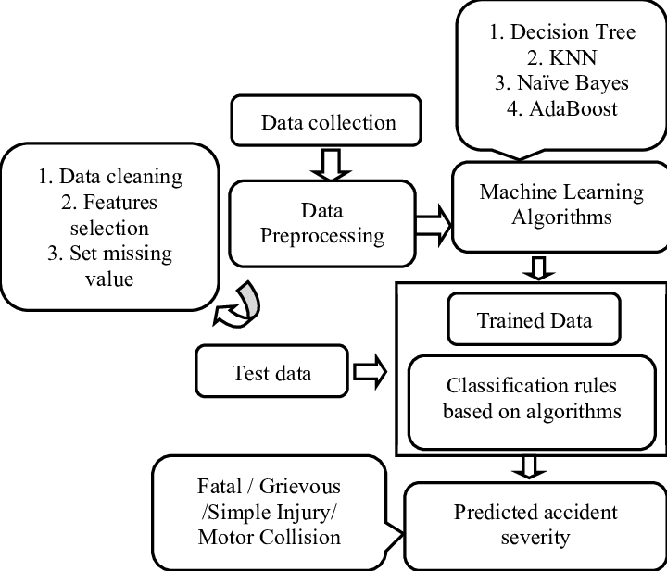
System Architecture:

Slide 9
Implementation:
Software requirements:
Operating System - Windows 10
Technology used – Python, Pandas,seaborn,matplotlib
Hardware requirements:
Processor- Intel Pentium i5 or above
RAM- 8 GB
the model was coded in Python.
The key components are Random Forest Classifier.
Random Forest Classifier is used in this for classification purpose.

Slide 10
Steps followed for Prediction:
Problem statement
Gathering the related data
Data preprocessing
EDA
Spliting,selecting ,training the model
Hyparameter tuning
Validation and deploying the model

Slide 11
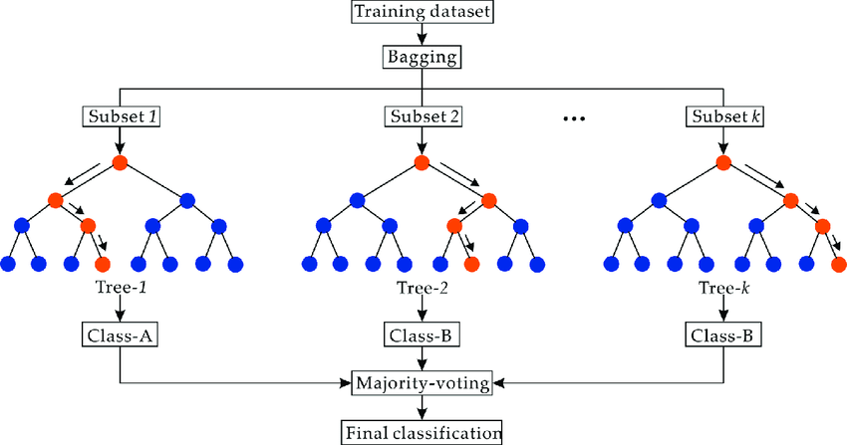
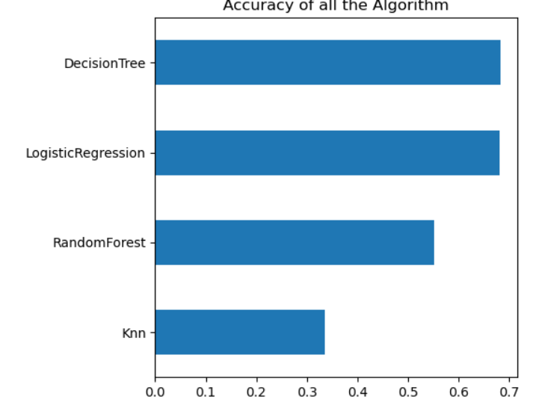
Algorithms and accuracy:

Slide 12
Code Implementation:
from datetime import datetime
import pandas as pd
df =pd.read_csv("C:/Users/jaya2/OneDrive/Documents/final data.csv")
def manual_testing(date, district):
print(date)
r=df.loc[(df['Accident Date']==date) & (df['District Area']==district),['Number_of_Casualties','Road_Surface_Conditions','Weather_Conditions']]
print(r)
date=input("Enter a date(dd-mm-yyyy format):")
district=input()
manual_testing(date,district)

Slide 13
Conclusion:
From this project we came to know
Types of Accidents
Location of Accidents
Types of Roads
Types of Vehicles Involved
Number of Vehicles and Casualties
Light and Weather Conditions

Slide 14
References:
[1] National Crime Records Bureau of Data, India, 2016
[2] The World Health Organization Global Status Report on Road Safety, The World Health Organization; Geneva, Switzerland, 2018
[3] Nikki Kattukkaran, Arun George, Mithun Haridas T.P., “Intelligent Accident Detection and Alert System for Emergency Medical Assistance”, IEEE International Conference on Computer Communication and Informatics, 2017
[4] Sanjay Kumar Singh, ”Road Traffic Accidents in India: Issues and Challenges”, World Conference on Transport Research - WCTR 2016 Shanghai. 10-15 July, 2016.
[5] Chaitali Khandbahale, Nikita Pawar, Jay Rathod, Karan More, ”Multi Object Detection in Vehicle for Accident Prevention and Safety Assistance using Embedded System - Implementation Paper”, International Journal of Engineering Research & Technology, May 5, 2019

Slide 15
Thank you

